Slide 1
机器人与人工智能实验室 Robotics and Artificial Intelligence Laboratory
WELCOME TO

Slide 2
Steering Gear Control
1. Principle
The control signal enters the signal modulation chip from the channel of the receiver to obtain a DC bias voltage.
It has a reference circuit inside and generates a reference signal with a period of 20ms and a width of 1.5ms. It compares the obtained DC bias voltage with the voltage of the potentiometer to obtain the voltage difference output.

Slide 3
Steering Gear Control
Finally, the positive and negative of the voltage difference is output to the motor drive chip to determine the positive and negative rotation of the motor.
When the motor speed is a certain value, the potentiometer is driven to rotate through the cascade reduction gear, so that the voltage difference is 0, and the motor stops rotating.

Slide 4
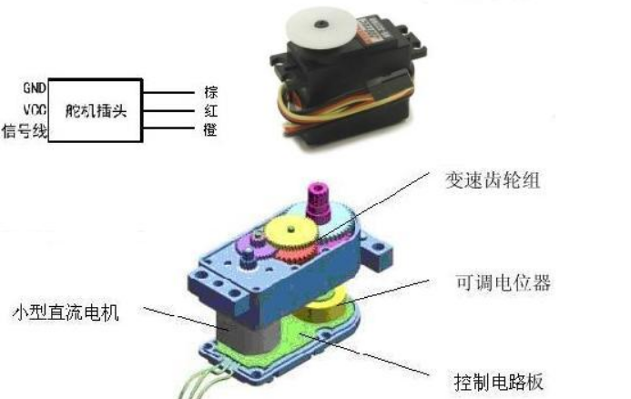
Steering Gear Control

Slide 5
Steering Gear Control
The control of the steering gear generally requires a time base pulse of about 20ms. The high level part of the pulse is generally an angle control pulse part in the range of 0.5ms-2.5ms, with a total interval of 2ms.
Taking 180 degree angle servo as an example, the corresponding control relationship is as follows:

Slide 6
Steering Gear Control
Correspondence
0.5ms--------------0 degree;
1.0ms--------------45 degrees;
1.5ms--------------90 degrees;
2.0ms--------------135 degrees;
2.5ms -------------180 degrees.

Slide 7
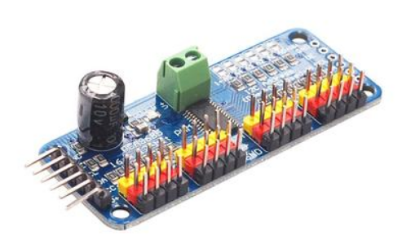
Steering Gear Control
PCA9685
Steering gear is driven through the chip. This chip uses the IIC communication interface to connect with Arduino. It can drive 16 servos at the same time with only 4 wires through IIC communication.

Slide 8
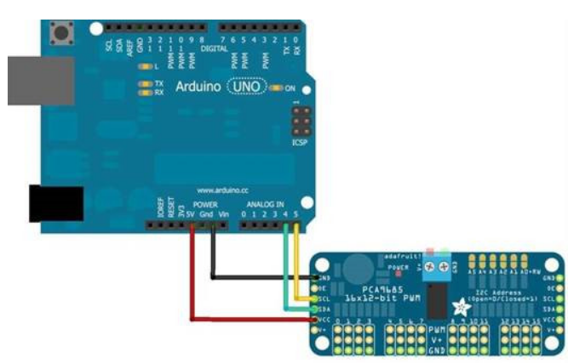
Steering Gear Control
Wiring mode of IIC communication interface with Arduino uno:
Arduino uno PCA9685
Gnd GND
+5V VCC
A5 SCL
A4 SDA

Slide 9
Steering Gear Control
Level and angle mapping:
150 -------- 0 degrees;
262 -------- 45 degrees;
375 -------- 90 degrees;
487---------135 degrees;
600---------180 degrees;

Slide 10
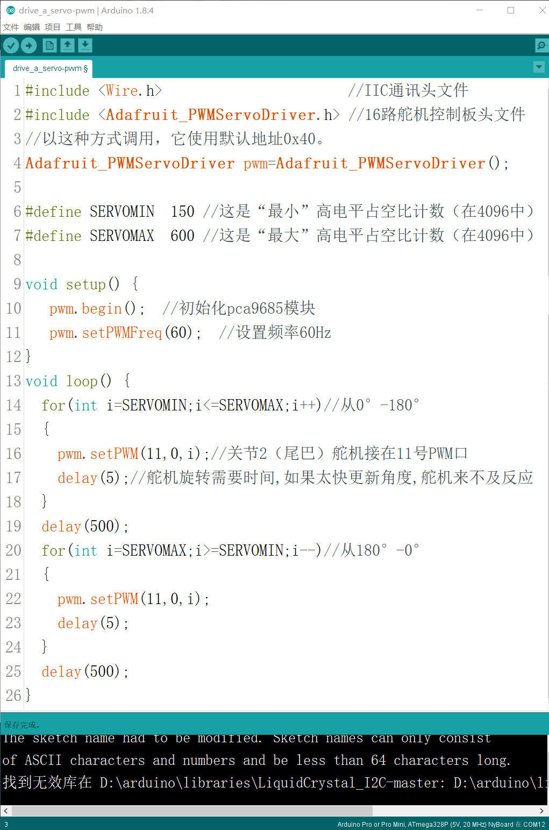
Steering Gear Control
2. Rotate the steering gear by PWM wave

Slide 11

Steering Gear Control
3. Rotate the steering gear through an angle of 0-180 degrees
Rotate directly in degrees and seal the specific PWM high-level duty cycle. We need to make a mapping between the two sets of data 0-180 degrees and 150-600.
We only need to map the first set of data 0-180 to the second set of data 0-450, and then add 150 bases to the second set of data.

Slide 12
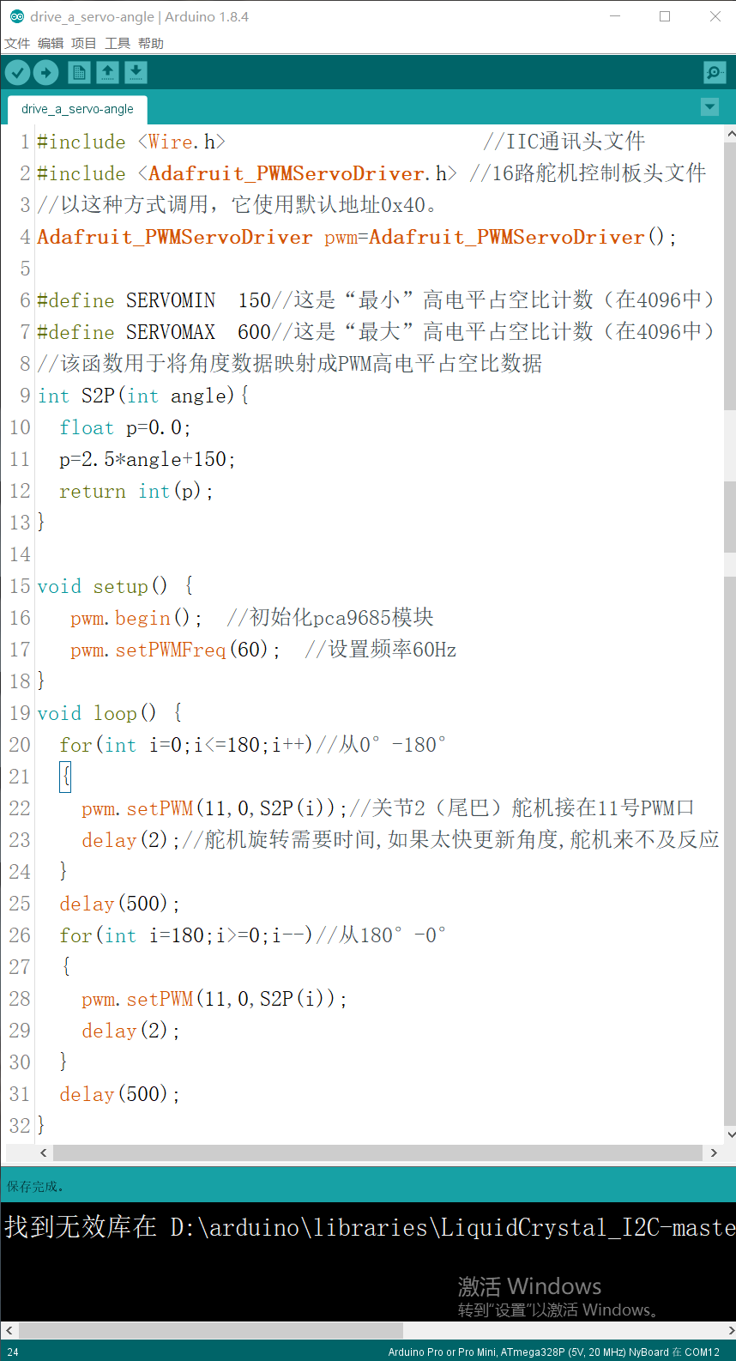
Steering Gear Control
Seal this angle mapping process into a function:

Slide 13
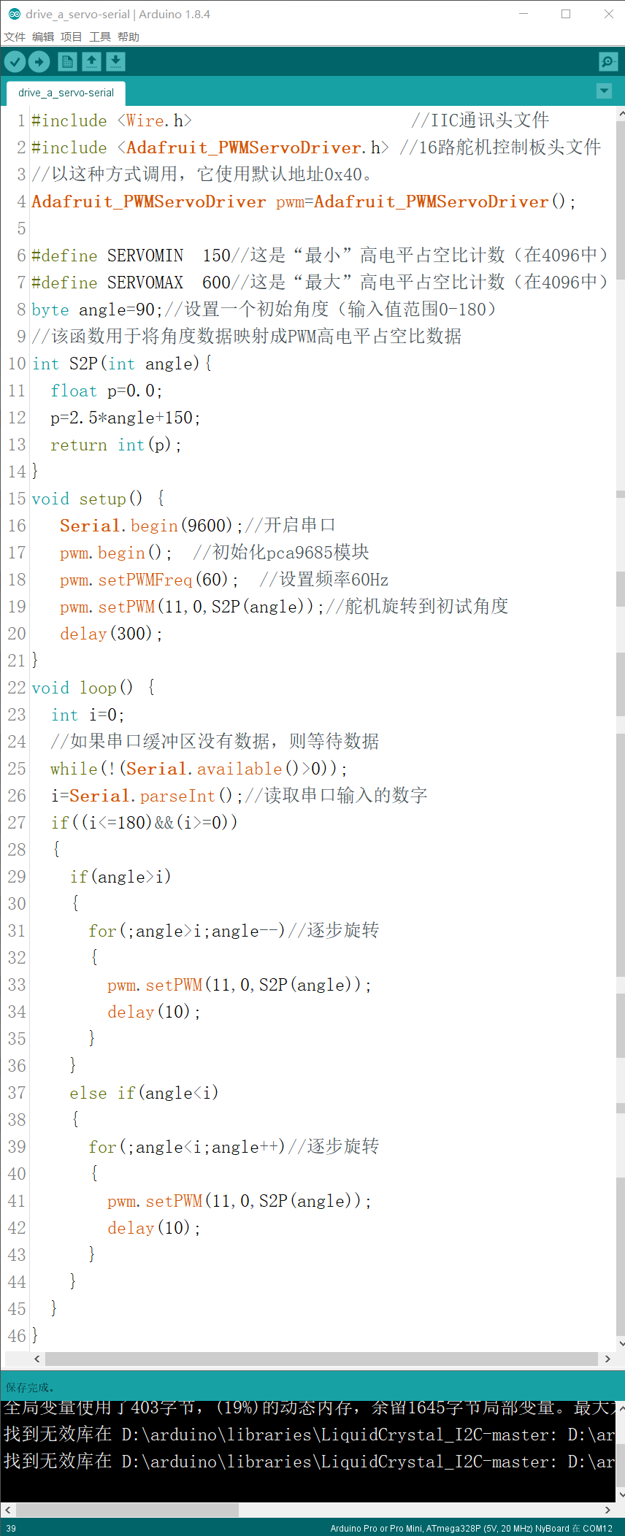
Steering Gear Control
4. Input the angle value through the serial monitor, and the steering gear rotates.

Slide 14
Steering Gear Control
Next:

Slide 15

THANK YOU
林天麟 教授
香港中文大学（深圳）
机器人与人工智能实验室
WeChat: tinlunlam

